Slide 1



BMI CALCULATOR
PROJECT GUIDE
PROJECT MEMBER
Shamsundar k
Pranav A S
Vishnu S

Slide 2
PROBLEM STATEMENT
Design and develop a BMI (Body Mass Index) calculator application that accepts user inputs for weight and height, computes the BMI using the standard formula, and categorizes the result into predefined BMI categories (underweight, normal weight, overweight, and obesity). The application should validate input data, handle unit conversions if necessary, and display the calculated BMI along with its corresponding category based on the computed value.

Slide 3
OBJECTIVE
The objective of this project is to create a user-friendly BMI (Body Mass Index) calculator application that allows individuals to quickly assess their BMI based on their weight and height inputs. The primary goal is to provide users with a straightforward tool to understand their BMI category, which is crucial for assessing potential health risks associated with weight status. By implementing this calculator, users will be empowered to make informed decisions regarding their health and well-being.

Slide 4
EXISTING SYSTEM
The application aims to enhance user experience through intuitive interface design and robust functionality. It will ensure seamless input handling, accommodating both metric (kilograms and meters) and imperial (pounds and inches) units with optional automatic conversion. The BMI calculation will adhere to the standard formula, ensuring accuracy in determining the BMI value. Additionally, the application will categorize the BMI result into well-defined categories (underweight, normal weight, overweight, and obesity) to provide users with clear interpretations of their BMI status. Error handling and input validation will be implemented to manage potential user errors and ensure reliable output. Overall, this project seeks to deliver a reliable, informative, and accessible tool that promotes health awareness and facilitates informed decision-making regarding weight management.

Slide 5
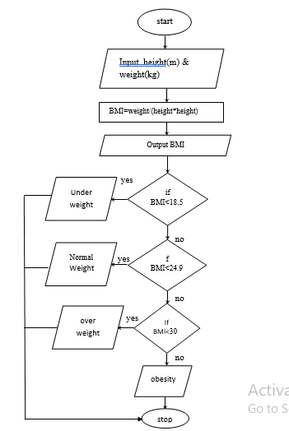
PROPOSED WORK – BLOCK DIAGRAM

Slide 6
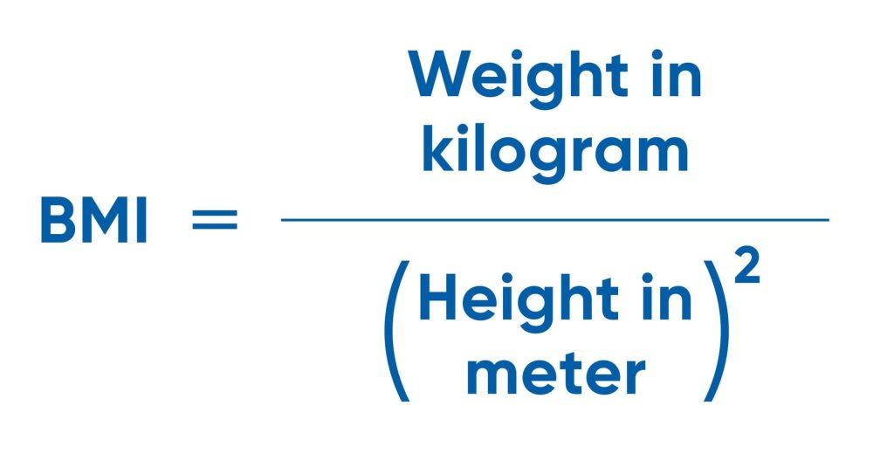
SOLUTION
calculate_bmi(weight, height, units):
This function calculates the BMI based on the given weight and height. It determines whether to use metric or imperial units based on the units parameter.
bmi_category(bmi):
This function determines the BMI category based on the calculated BMI value:
"Underweight" for BMI less than 18.5
"Normal weight" for BMI between 18.5 and 24.9
"Overweight" for BMI between 25 and 29.9
"Obesity" for BMI 30 or greater.

Slide 7
CONCLUSION
In conclusion, the BMI calculator application developed provides a practical and user-friendly tool for individuals to assess their Body Mass Index (BMI) quickly and effectively. By allowing users to input their weight and height in either metric or imperial units, the calculator ensures flexibility and ease of use across different measurement systems.

Slide 8
THANK YOU

